Slide 1
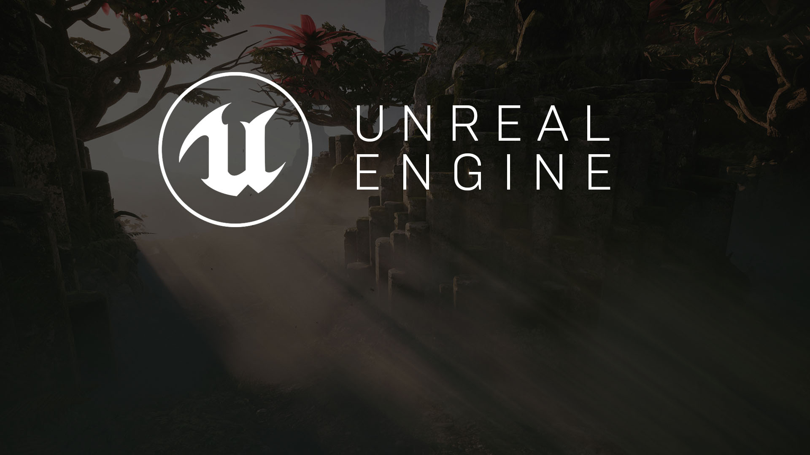
hour 2, lecture 2
Working with Assets:
Importing, Migrating, and the Reference Viewer

Slide 2

Introduction
When starting a new project, you will need some assets to work with.
Epic has already given you the ability to create a new project with starter content. This is great, because it gets you up and running fast.
At some point you will need to bring in your own content. Content can be imported in several ways. In this lecture, you will learn the common ways to bring in new assets and migrate content from one project to another. You will also become acquainted with the Reference Viewer.

Slide 3
Lecture Goals and Outcomes
Goals
Outcomes
The goals of this lecture are to
Learn how to import assets
Learn how to migrate content from one project to another
By the end of this lecture you will be able to
Import assets created in other applications
Migrate content from one project to another

Slide 4
Importing Assets
Working with the Content Browser
Notes:
VR exists through the melding of hardware and software. There are various devices and software solutions you need to be aware of when getting into creating VR content.

Slide 5
Importing Content
UE4 supports a variety of file types for importing content. You can import content created in an external editor.
Common examples:
3ds Max or Maya for models
Photoshop for Textures
Audacity for sounds

Slide 6
Asset Type | File Extension | Application
3D models, Skeletal Mesh rigs, animation data | .fbx, .obj | Maya, 3ds Max, ZBrush
Textures and images | .bmp, .jpeg, .pcx, .png, .psd, .tga, .hdr | Photoshop
Fonts | .otf, .ttf | BitFontMaker2
Audio | .wav | Audacity, Audition
Video and multimedia | .wmv | After Effects, Media Encoder
PhysX | .apb, .apx | APEX PhysX Lab
Other | .csv | Excel
Some of the Most Common File Types and the Asset Types and Some Applications They Are Associated With

Slide 7
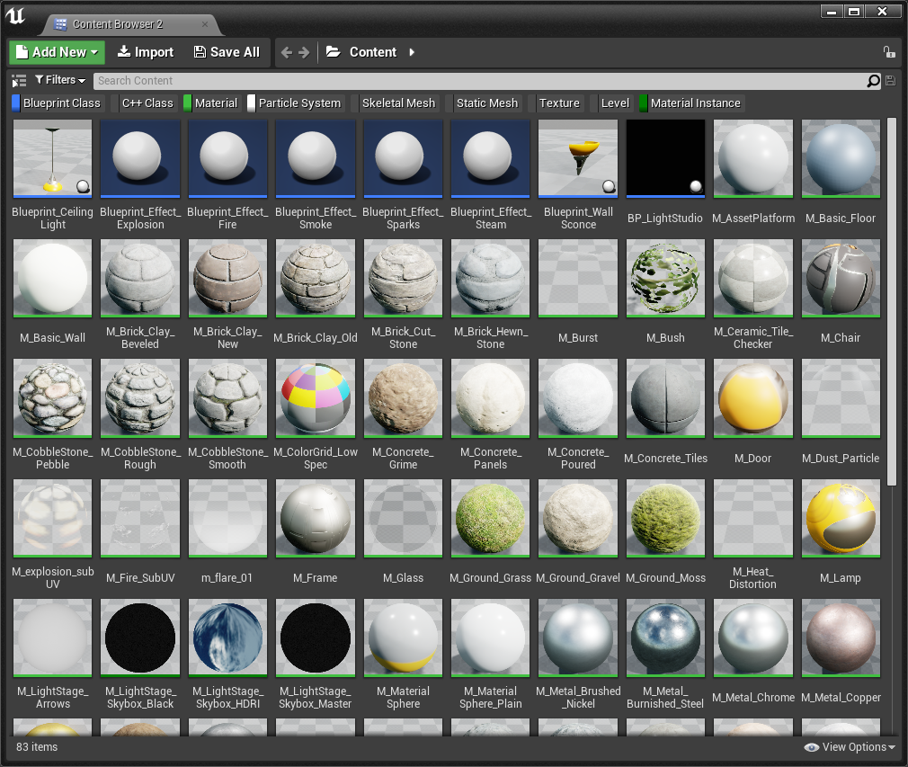
Other Asset Types
There are many assets that are not imported but are created directly in the Editor.
Common examples:
Blueprint classes
Particle Systems
Materials and Material Instances
Content Browser

Slide 8
Importing Assets:
File Organization
Good file organization is important. Before importing content into the engine, you should organize your external files.
If you ever need to make changes to the original assets, they can easily be updated and reimported with the Reimport command.

Slide 9
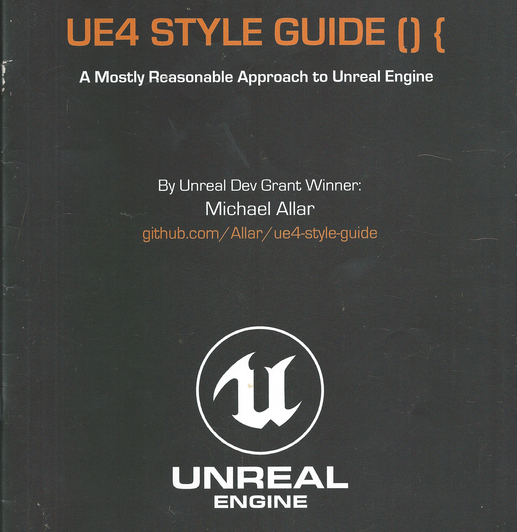
Naming conventions
Another aspect of good file organization is naming conventions. Epic has created a style guide that establishes a best practice for naming assets and organizing files in the Content Browser once the assets have been imported.
http://ue4.style/
UE4 Style Guide

Slide 10
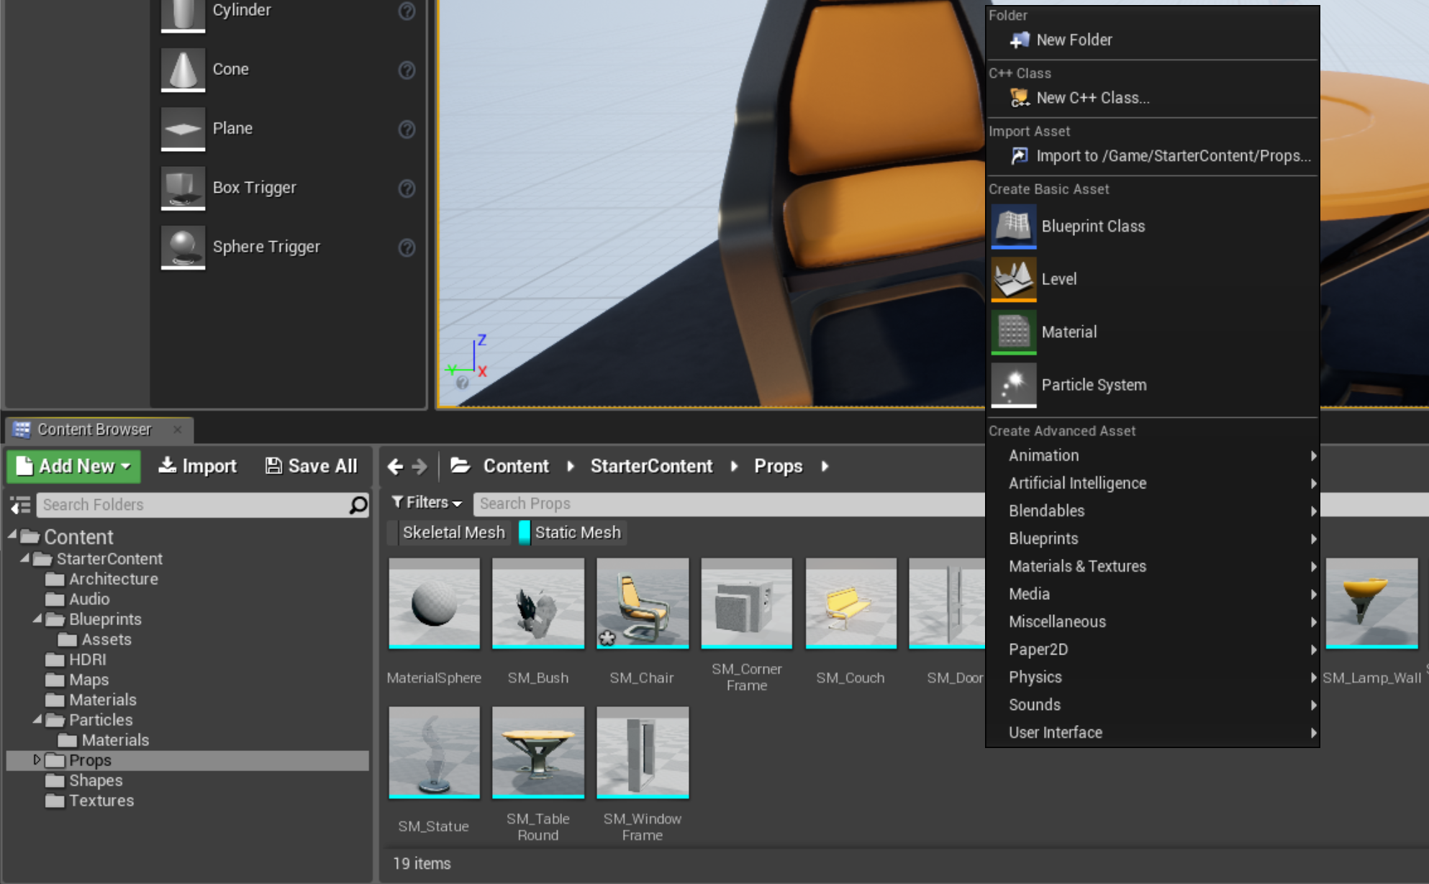
Importing Assets: Content Browser
There are a few ways to bring content into a project.
Following are two common ways to import external content created in an external application:
Use the Content Browser by clicking the Import button or by right-clicking in the asset view and selecting Import To.
Go to your operating system’s file manager, select the file you want to import, and drag and drop it into the Content Browser.
Content Browser with context menu

Slide 11
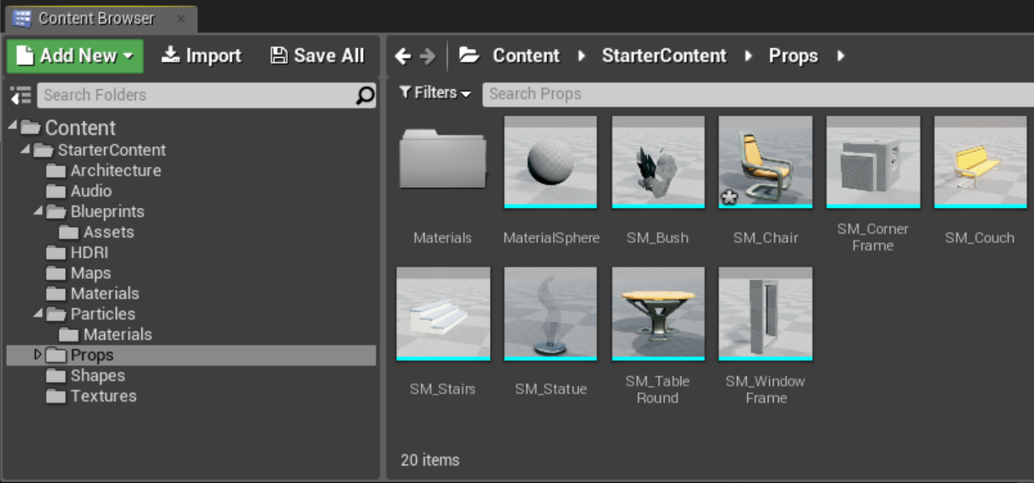
Importing Assets: Asset Icons
Asset icons in the Content Browser give you a preview of most assets so you don’t have to open them up. If you roll the cursor over an icon, you see relevant information about the asset.
A small asterisk in the lower-left corner of an asset’s icon tells you that the asset has not been saved.
You must save imported assets for them to be written to disk.
Imported assets that are not saved will disappear once the Editor is closed.
Press Ctrl+S to save all the assets, or right-click an asset and choose Save.

Slide 12
Importing Assets: Content Browser Filters
The more content you have in a project, the harder it can be to find what you are looking for.
At the top of the asset view in the Content Browser are a search box and filter tools.
Both are relevant to the folder that is selected in the Source panel—that is, they show only what is in the folder that is currently selected as well as its subfolders.
If you select the Content folder at the top, the search box and filter tools apply to the Content folder and all its subfolders.

Slide 13
Exercise
Create a new blank project with starter content or use an existing project.
Create a new folder in the Content Browser and import provided assets into the folder.

Slide 14
Importing Assets
Migrating Content from One Project to Another

Slide 15
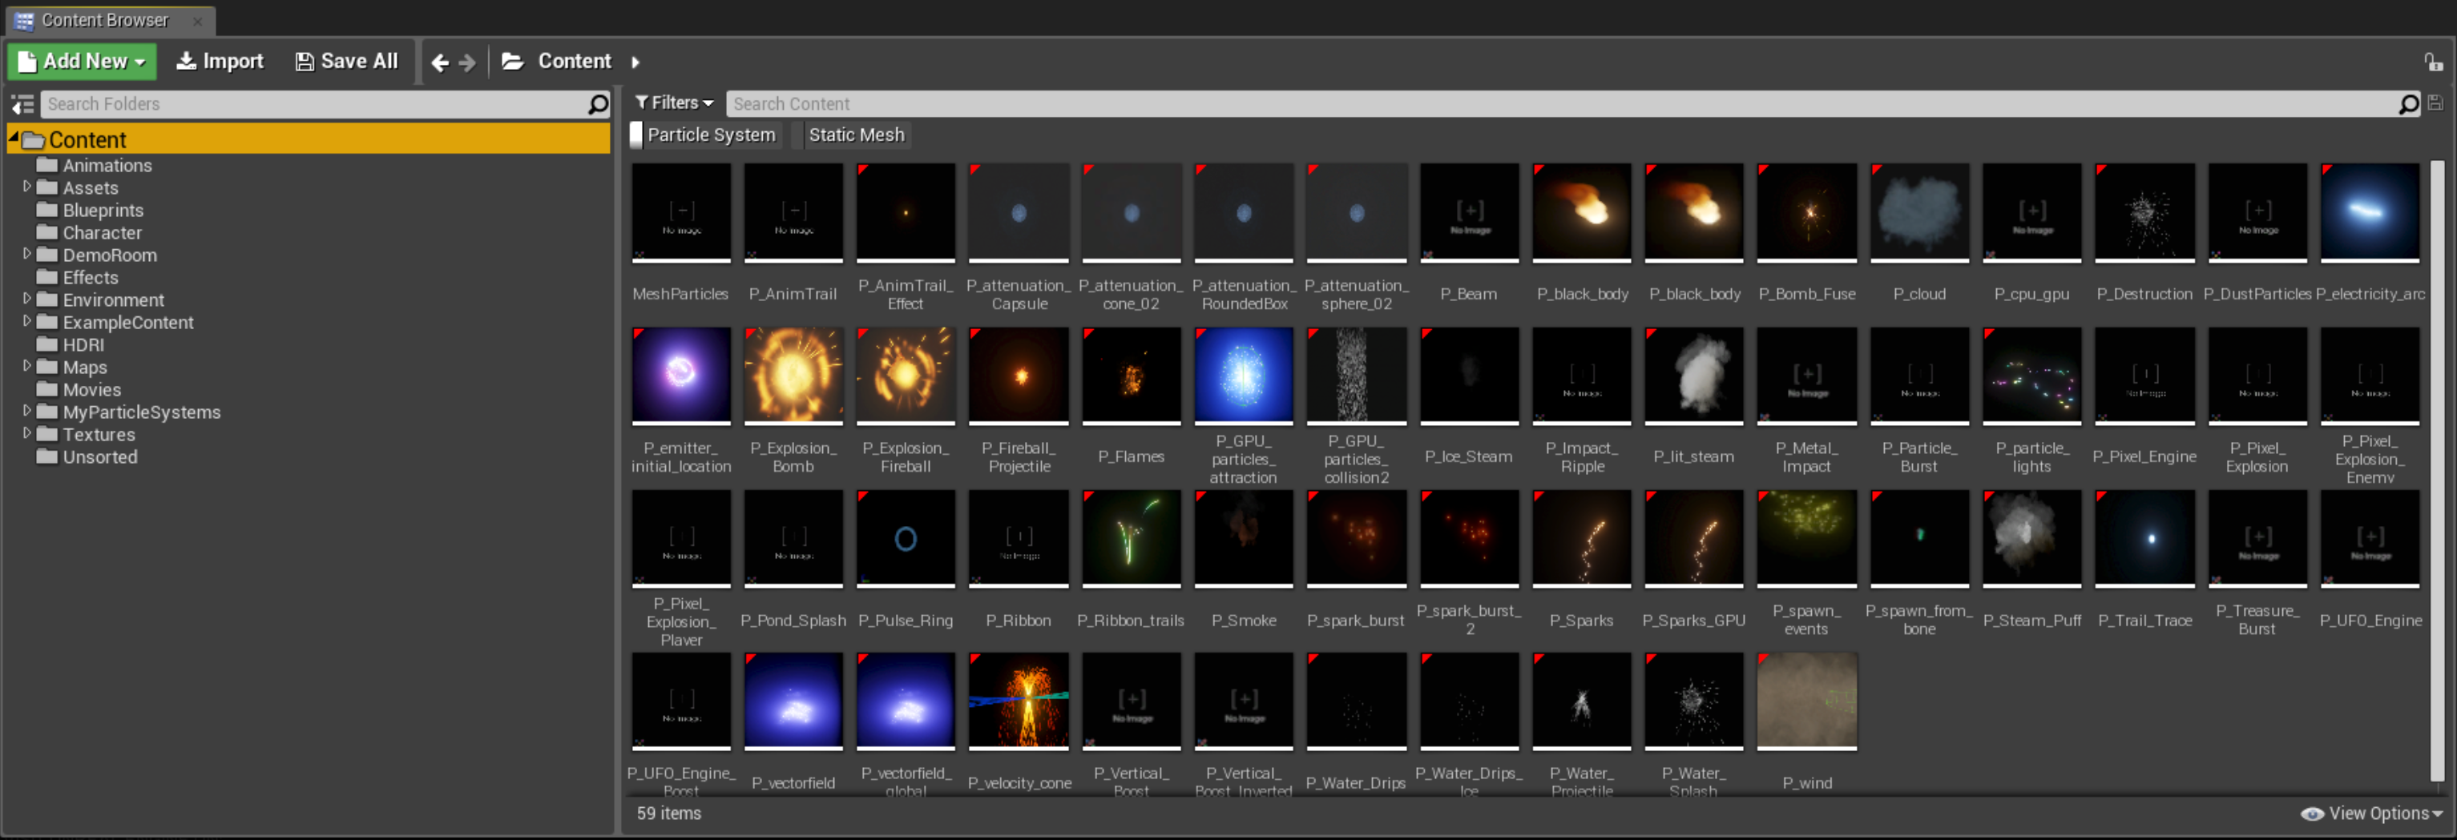
Importing Assets: Migrating Content
Another way to add content to a project is to migrate it from an existing project.
Migrating allows you to move assets from one project to another.
When you migrate content, you also move asset dependencies while maintaining the folder structure.

Slide 16
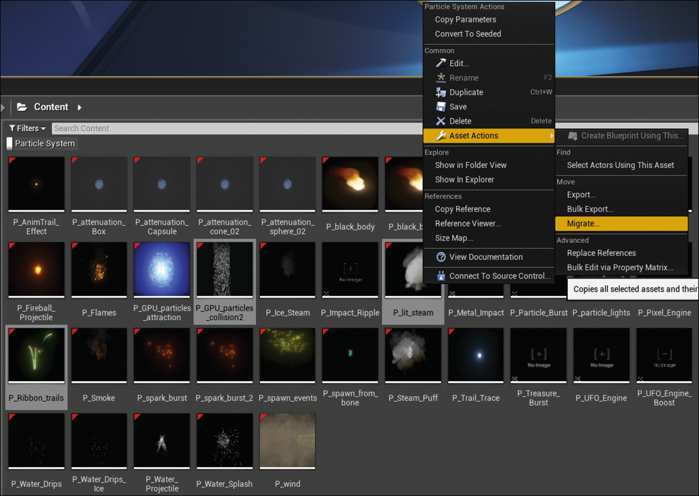
Importing Assets: Migrating Content
To migrate content:
Open the project you want to migrate content from.
In the Content Browser, select the assets you want to migrate.
Right-click on one of the selected assets and go to Asset Actions and select Migrate.

Slide 17
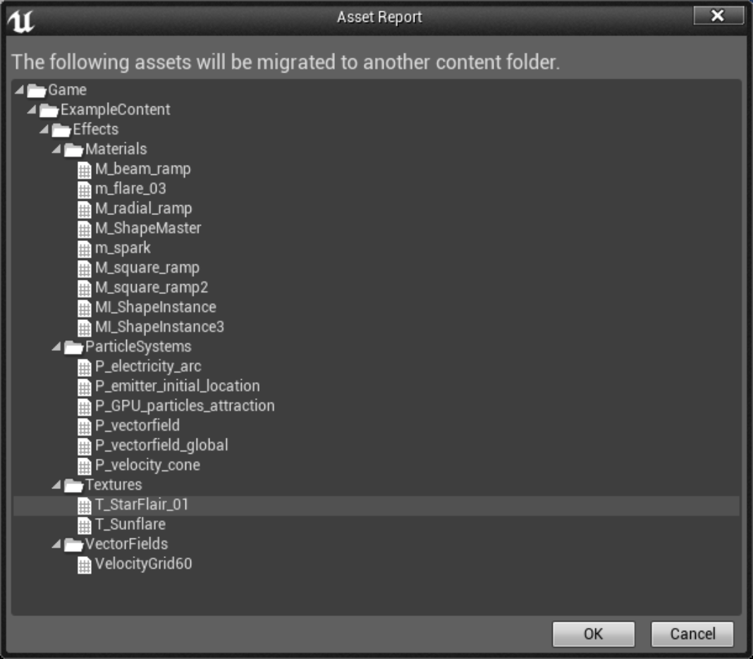
Importing Assets: Migrating Content
The Asset Report lists all the assets that will be migrated to the target project.
In the Asset Report pop-up, click OK.

Slide 18
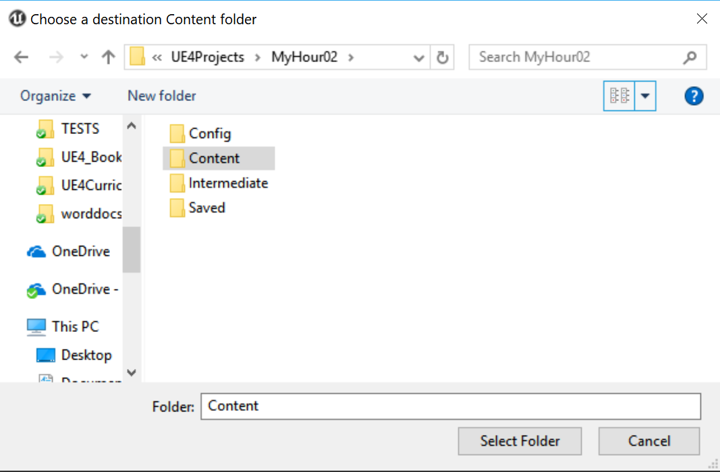
Importing Assets: Migrating Content
In the Choose a destination Content folder window, locate the Content folder of the project you want to migrate to.
Select the folder and click the Select Folder button.
When finished, UE4 will tell you if the content migrated successfully.

Slide 19
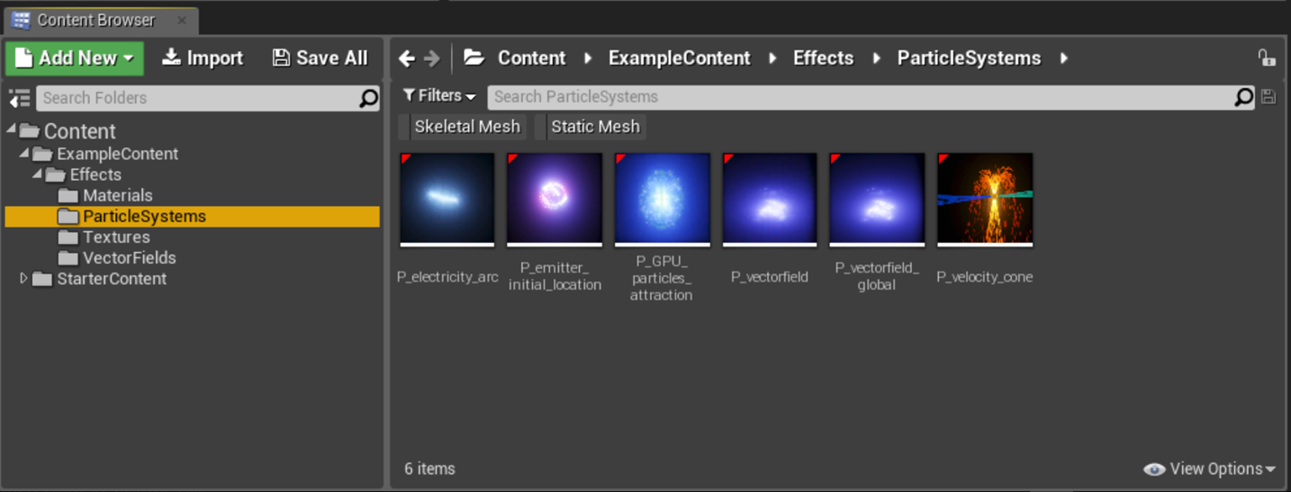
Importing Assets: Migrating Content
Open the destination project and look in the Content Browser to find the migrated content.
Note: When you migrate content from one project to another, you will also move asset dependencies while maintaining the folder structure. So if you already have files in your project with the same name and folder structure, they will be overwritten with the newly migrated content.

Slide 20
Exercise
Create a new blank project with starter content or use an existing project.
Download and create the Content Examples Project or any project found in the Learn section of the Epic Launcher.
Migrate content from the Learn section project to your blank project.

Slide 21
Importing Assets
Reference Viewer

Slide 22
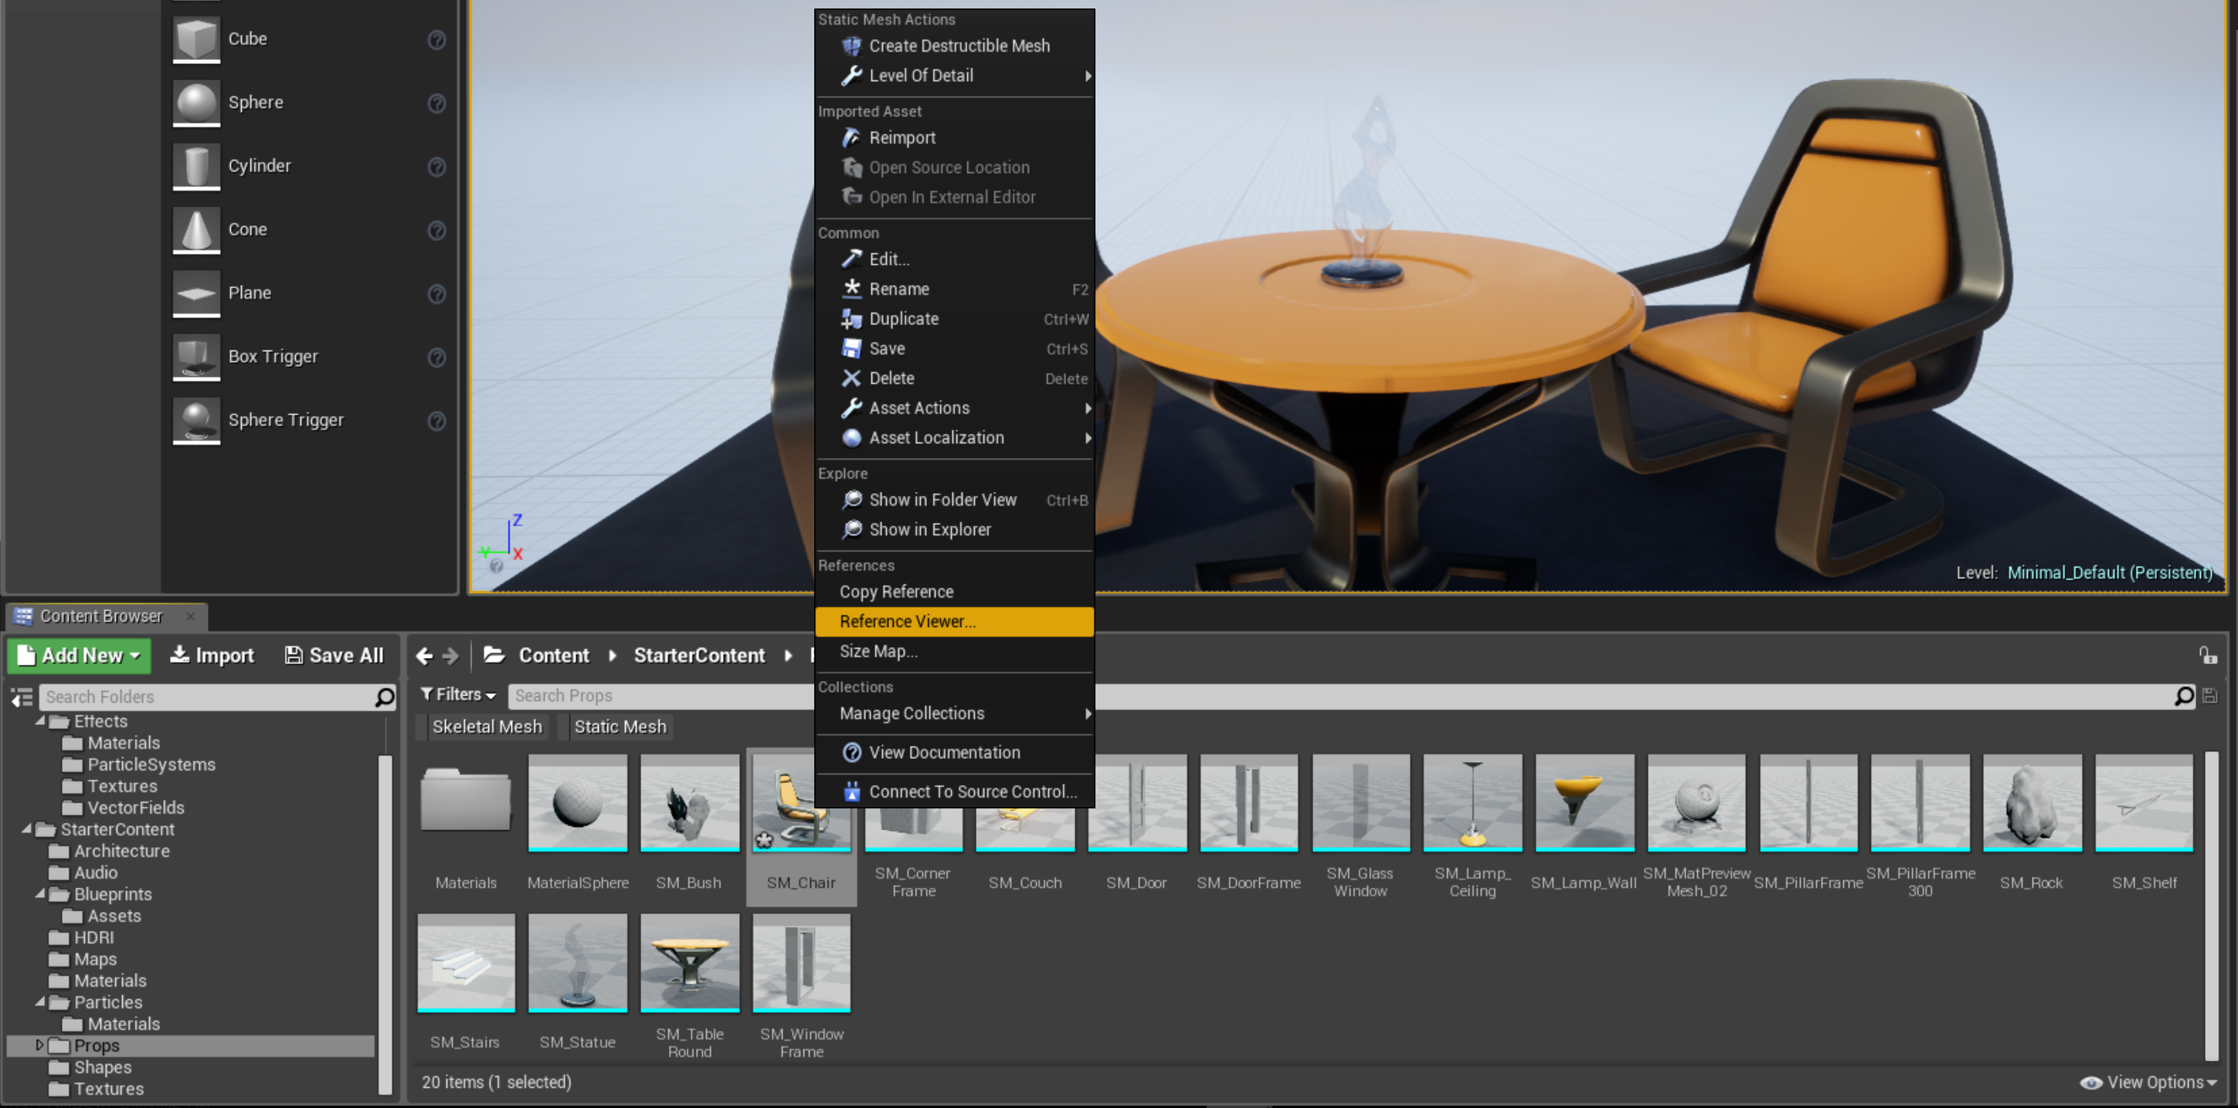
Importing Assets: Reference Viewer
The Reference Viewer shows the dependencies for an asset.
To see the asset references for an asset, right-click it in the Content Browser and select Reference Viewer.

Slide 23
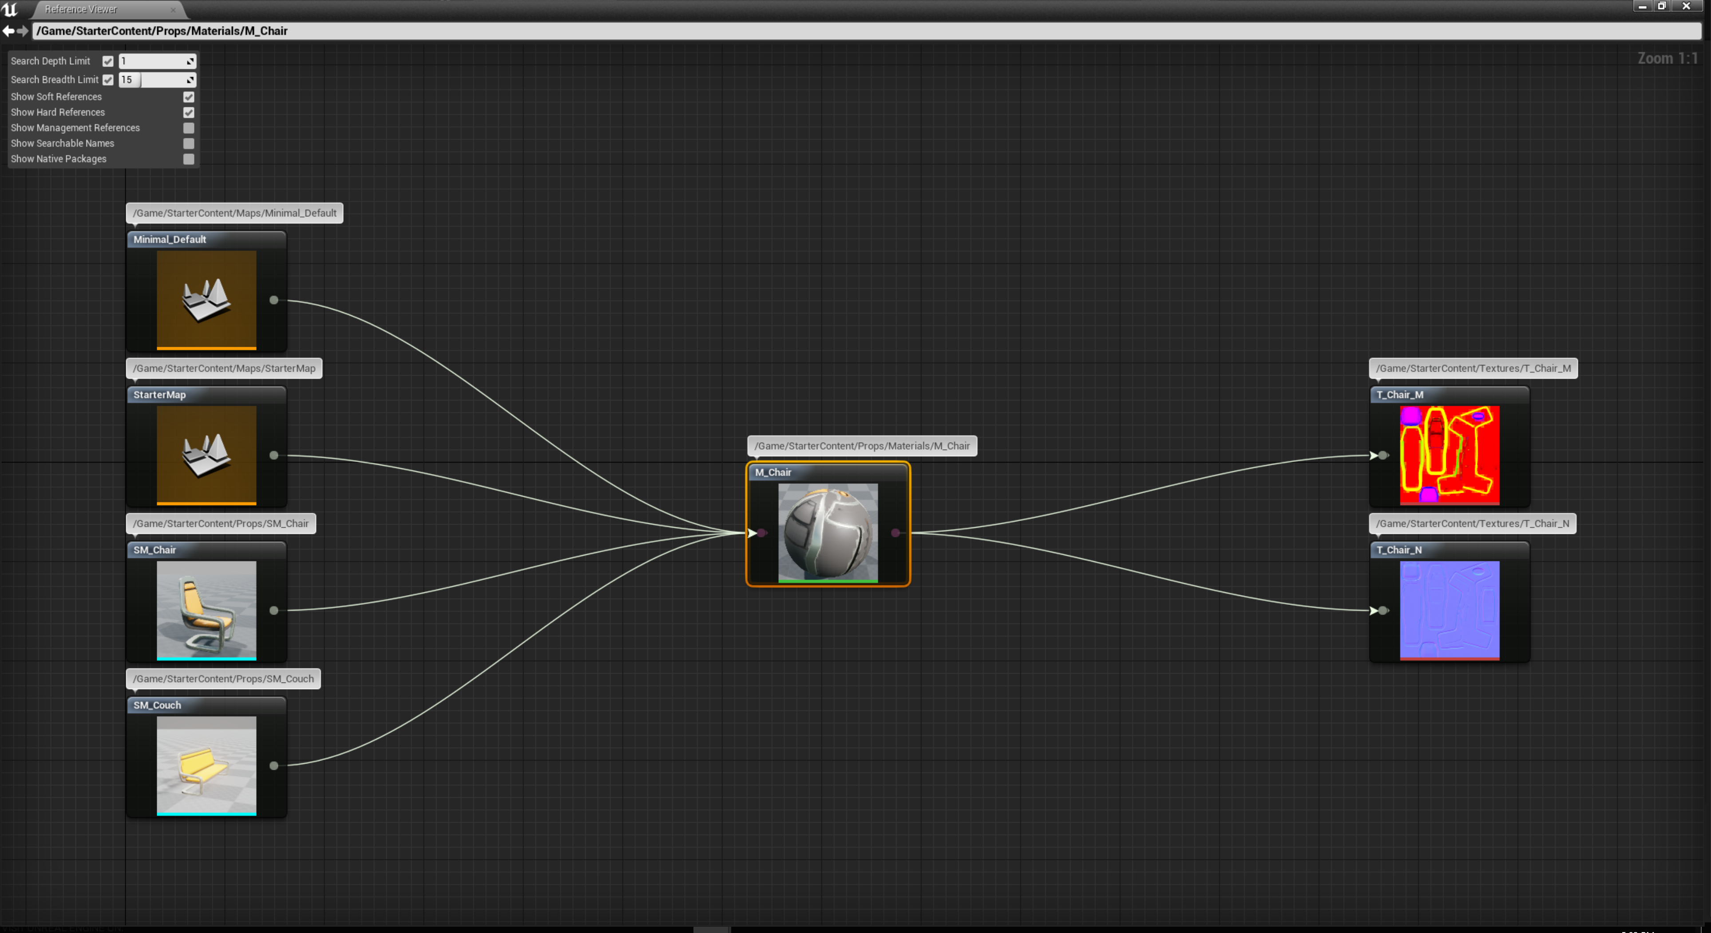
Importing Assets: Reference Viewer
Most assets are dependent on one or more other assets.
For example, if you assign a Material to a Static Mesh asset in the Static Mesh Editor, the Static Mesh is now referencing the Material.
This means that when the Static Mesh asset is loaded, it also needs to load the referenced Material.
In turn, the Material will load the Textures that have been referenced in the Material Editor.

Slide 24
Importing Assets
Moving Assets to a New Folder
Tip
When you move an asset to a new folder in the Content Browser, the Editor updates asset references and dependencies.
You may be tempted to move .uasset files around manually or copy them from one project to
another using Windows Explorer/Finder.
Although doing that technically works, it is not good practice because of dependencies.
You should always migrate content or make changes to folder structure and file locations in the Content Browser so the Editor can update dependencies.

